Slide 1

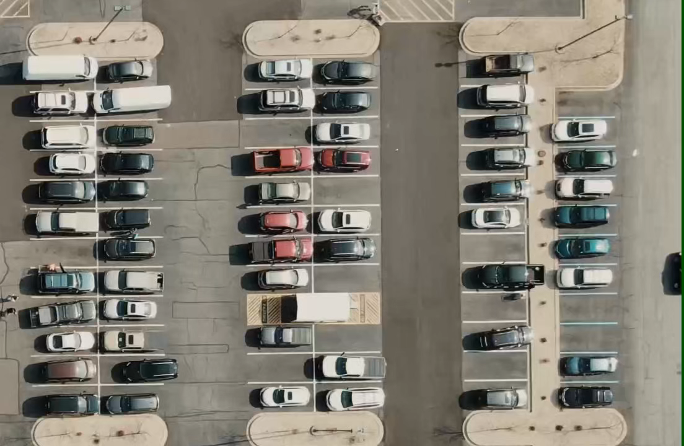
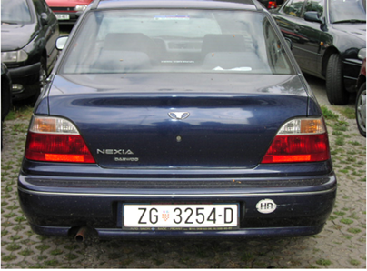
Car parking 3.0
in this project we realize a code that simulate a quite smart parking that is able to
Recognize car license plate of the veichle inside
From a camera put on the top, counting in real time
Wich park are taken
The parking available
Photo taken from enter
Video of the parking from the top

Slide 2
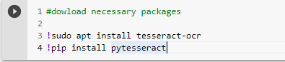
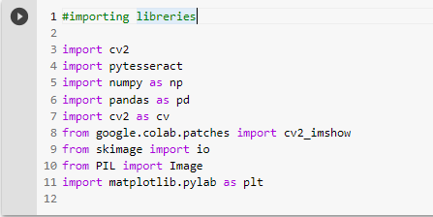
License plate recognize
This project has been implemented in phyton language using colab, a very usefull ide implemented by google.
Before starting we have to install pytesseract, a library for CV that allow us to traslate a word inside a photo in a string var.
Here we import the necessary library usefull for our project.

Slide 3
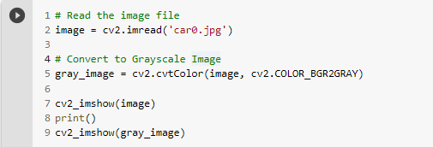

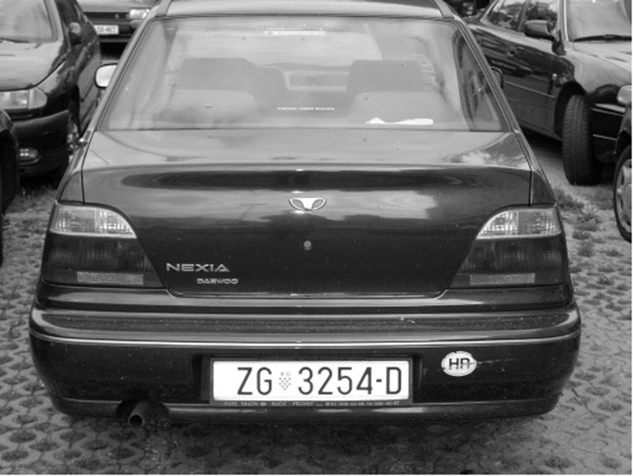
Gray scale
INPUT:
GRAY FILTERING
DESCRIPTION OF CODE:
We import the origin image with cv2_library
converting the initial image in gray one, applying a gray_ filtering in cv2_library using the : cv2.COLOR_BGR2GRAY code
This simplify canny edge detection to detect the edges
OUTPUT

Slide 4
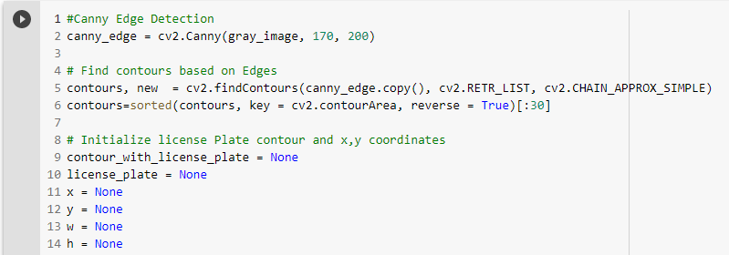
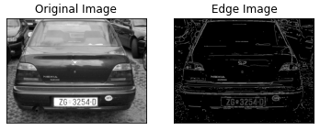
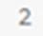
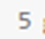
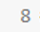
Parameters of tesseract library
DESCRIPTION OF CODE:
Using canny edge detection we detect all edges of the image
With find countours applicated at canny edge, we save the contour of the image specifing the mode of retrivial ( 2’ parameter) and the approximation ( 3’ parameter )
With sorted we put in order the contours found, deleting that ones are < 30
Than we initilize license plate variable defined by (x+w) (y+h) coordinate of initial image
CHAIN APPROX_SIMPLE

Slide 5
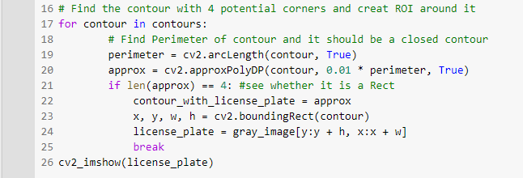
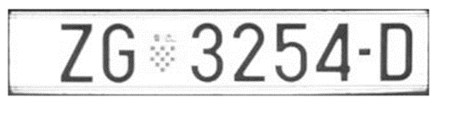
Parameters of tesseract library
OUTPUT:
DESCRIPTION OF CODE:
Analyzing all countour find with a for loop
Misuring the lenght of each with arc lenght
And using approxPolyDP we search in contours known figures like rectangular with 0,01 precision to identify the the region of the original image where there is licence plate.
If we found the rectangle, we found the licence plate, so we save the coordinates in the datas created before.

Slide 6
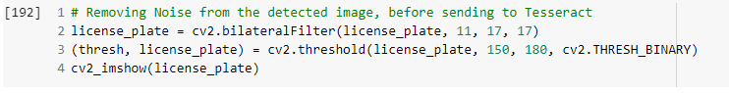
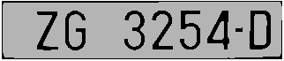
bilateral filter
INPUT:
Before filtering
OUTPUT:
After filtering
Bilateral filtering
DESCRIPTION OF CODE:
For removing noise we apply: Bilateral filter -> to clean the license plate smothing the image
Binary threshold -> to increase the contrast ( helping pytesseract library to capture the letters )

Slide 7
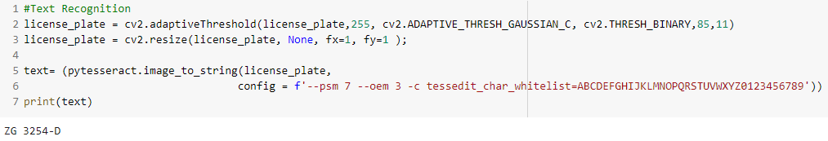
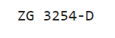
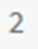
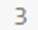
Parameters of tesseract library
OUTPUT: ora la targa è una stringa manipolabile
DESCRIPTION OF CODE:
To allow pytesseract library to capture the string of the license plate is still necessary to manipulate the region of interest of the image with other filtering:
adaptive_thresh_gaussian and thresh_binary filter
trying to resize the image
With pytesseract.image_to_string code we capture at the end the license plate and we save it in a string variable that can be manipulate in the future

Slide 8
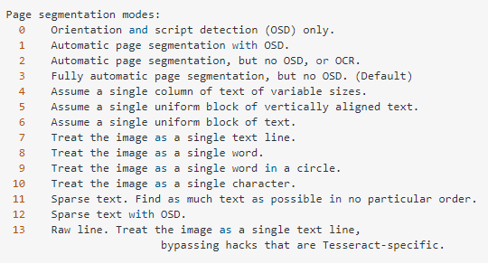
Parameters of tesseract library
To capture the license plate ‘’ pytesseract.image_to_string ‘’ has to be proper config.
psm:
tessedit_char_whitelist:
Limit the function at a preset of char (white list) while we known the licence plate is composed by 0-9 and A-Z char.

Slide 9
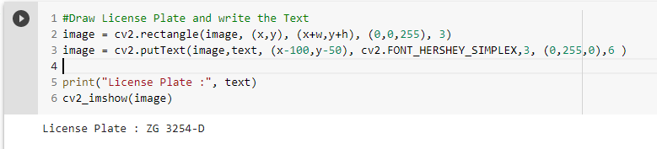
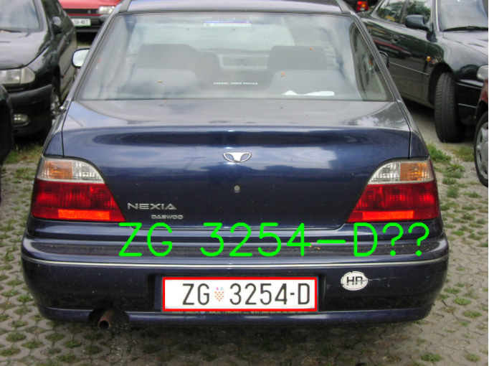
Final output
RESULT
DESCRIPTION OF CODE:
Overlap rectangle we found to the initial image to identify the license plate
Hold on the text found with pytesseract in the string variable to
See that it can be now manipulate.

Slide 10
Parking counter
This part of the project consist to count the parking places in real time video with an interactive code.
2 codes have been used:
to select existing parking slots
for counting in real time the number of free spaces

Slide 11
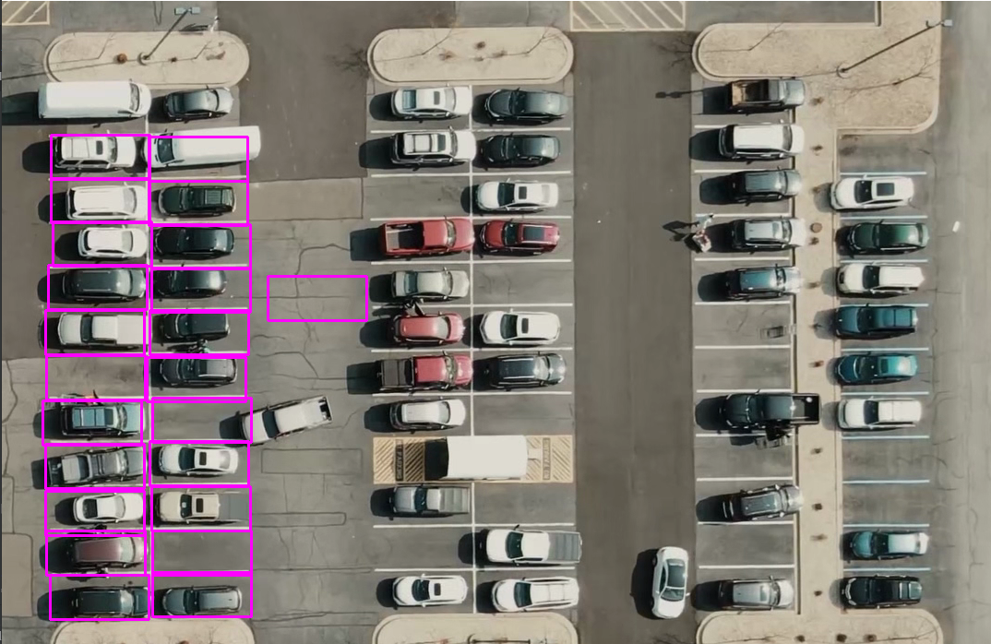
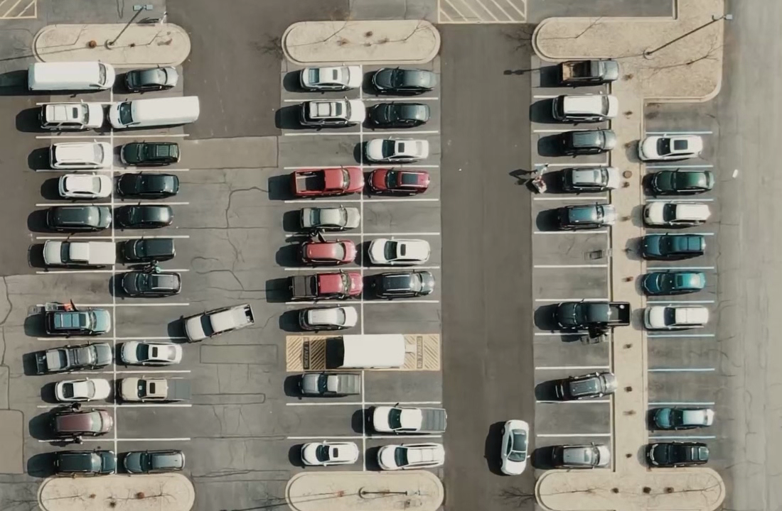
Select parking slots
We pick manually each parking with the mouse
We save the configuration into a file to export to the next program
From a photo of the entire parking

Slide 12
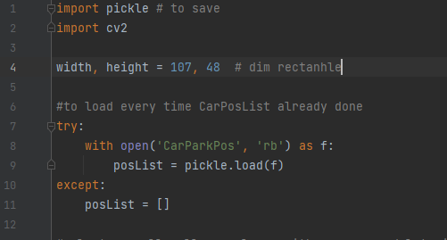
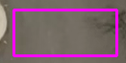
Select parking slots
rectangle indicating a single parking slot
DESCRIPTION OF CODE 1:
Import necessary libraries
Create a rectangle with the same dimesion of the parking
Load the photo of the parking

Slide 13
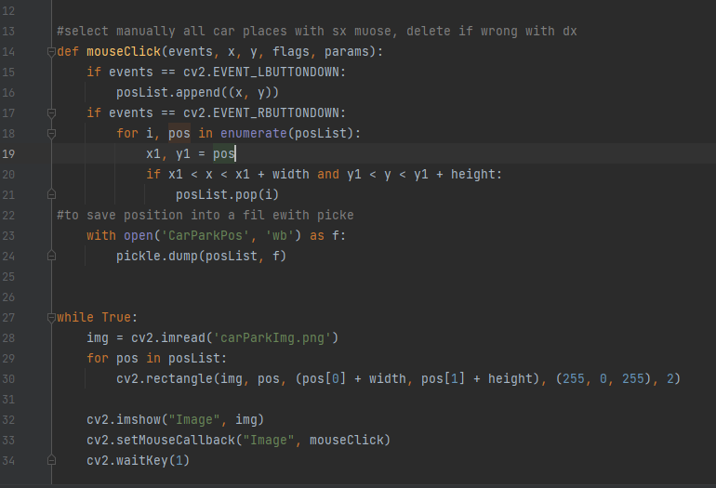
Select parking slots
DESCRIPTION OF CODE 1:
select parking slot with the mouse in the photo, upper left corner
Sx_button to mark zone
Dx_button to delete zone already marked (wrong)
Save position marked into a file named « CarParkPos »
Finally show parking image and each rectangle indicating avaery parking slot

Slide 14
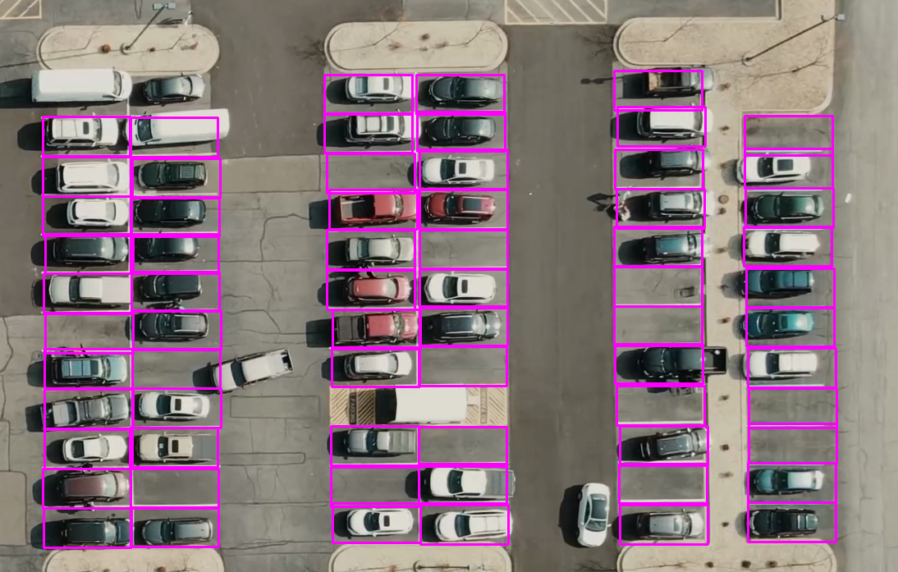
Final output program 1
Final output of the first program

Slide 15
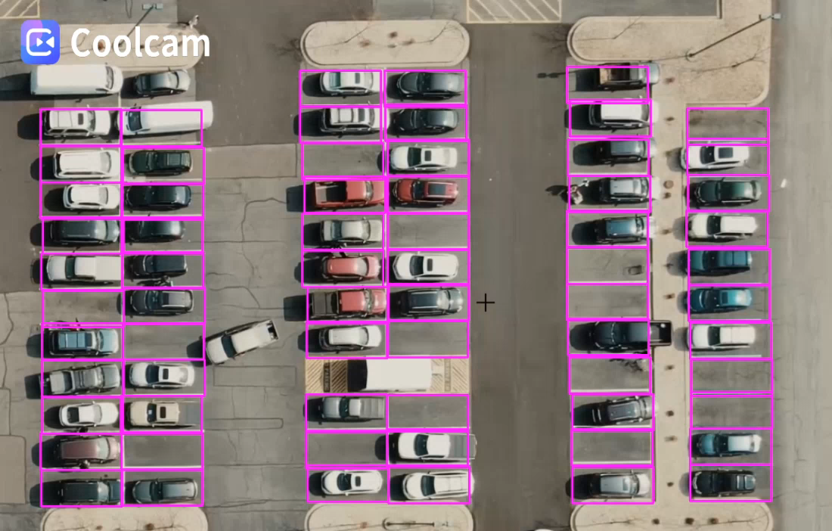
counter parking space
We overlap the file created early to identify in the video the zone of parking.
We manipulate each zone to see if the car is present or not in order to count them.
Starting from the video of the parking

Slide 16
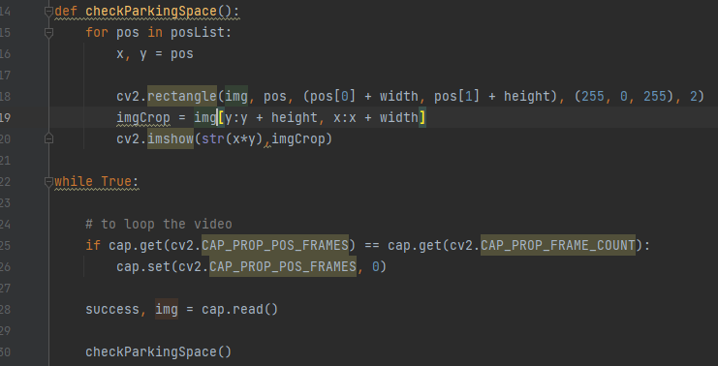
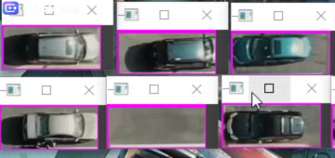
Separation of parking
we separete each parkin in a small portion of video to manipulate it
DESCRIPTION OF CODE:
Inside checkParkingSpace we define the portion of the video of each parking
output

Slide 17
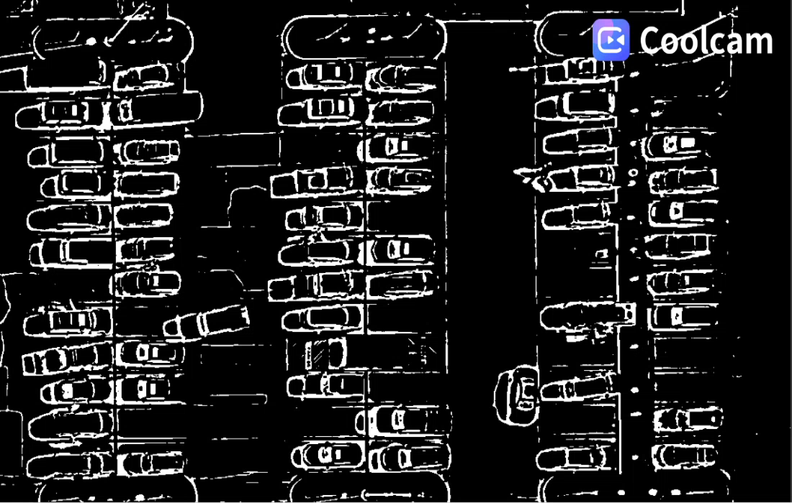
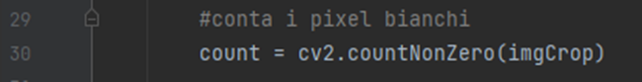
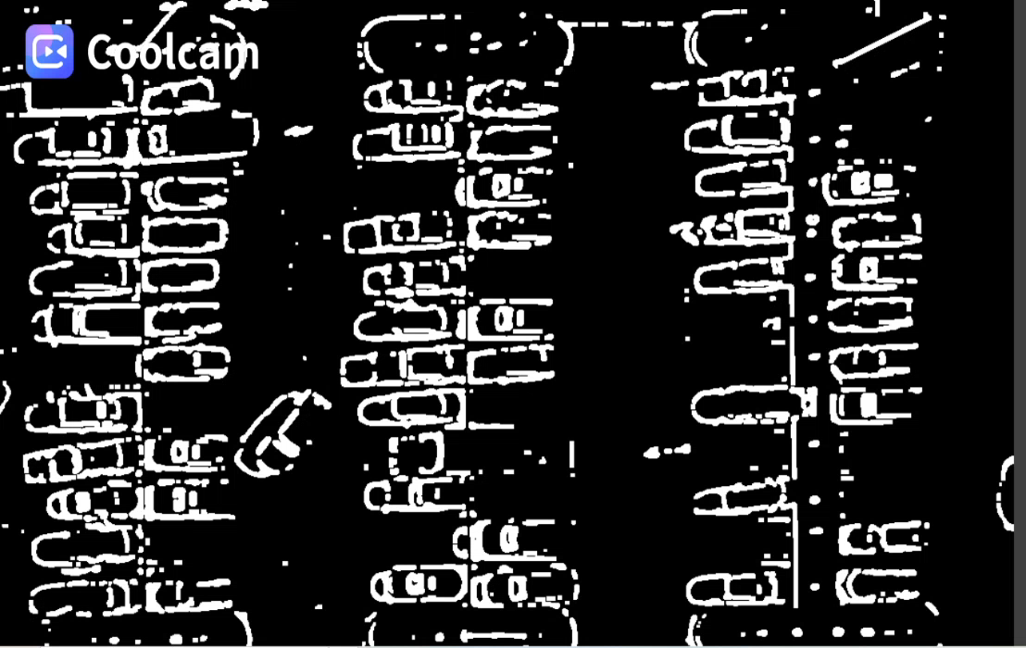
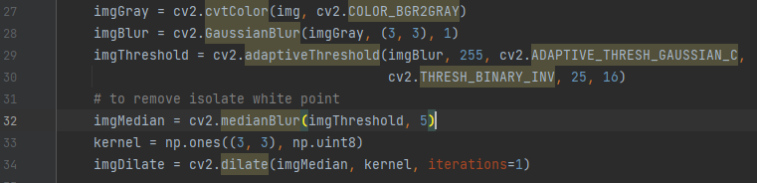
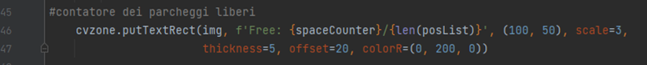
Manipulation and counter
Filter image to black and white (binary image)
Add some filters to better manipulate the image
Gaussian blur --> smoothens the image
medianBlur --> to remove a little bit salt and pepper noise
Count white pixels of every parking region:
Pixel > threshold (900) --> parking taken
Pixel < threshold (900) --> free parking
Sum every parking region which has number of white pixels > threshold

Slide 18
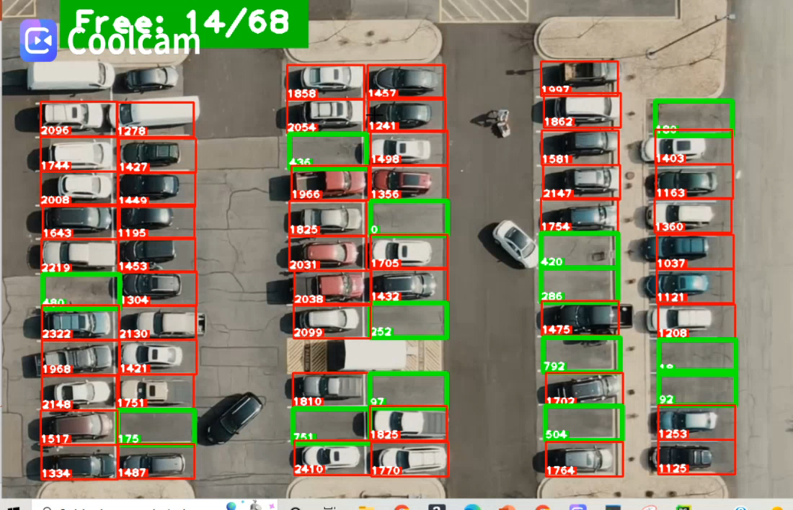
Final output

